Slide 1
YALOVA UNIVERSITY
DEPARTMENT OF BUSINESS ADMINISTRATION
PRACTICAL TRAINING
DECEMBER-2023

Slide 2
TABLE OF CONTENTS
Practical Training Course
Description
Aim
Duration and Time
Prerequisites
Suitable Institutions
Practical Training Workflow
General Provisions
Student Duties and Responsibilities
Assessment and Evaluation

Slide 3
DESCRIPTION OF PRACTICAL TRAINING COURSE
Compulsory or elective course organized for students to gain experience about the practices and processes in institutions related to the field they study by using the knowledge and skills they have acquired during their education (Yalova Unv. FEAS Practical Training Course Directive, Article 4/b).

Slide 4
AIM OF PRACTICAL TRAINING COURSE
ARTICLE 12- (1) The aims of the practical training course are;
To reinforce students’ knowledge and experience gained during their education period,
To introduce the organizational structure of the institution and to gain work discipline,
To gain the ability to use the theoretical and practical specialization knowledge they have received and to transfer it to practice,
To gain the habit of doing business together by acting in a team spirit in the institutions where they do practical training,
To provide the opportunity to follow the technological developments in the sector,
To increase the employability level of students.
(Yalova Unv. FEAS Practical Training Course Directive)

Slide 5
DURATION AND TIME OF PRACTICAL TRAINING
ARTICLE 14- (1) The practical training course is held in the eighth semester in accordance with the academic calendar.
(2) If no practical training course is offered in the departments, other theoretical elective courses for at least 20 (twenty) ECTS are offered by the department.
(3) Students taking practical training courses submit their work as a report at the end of the semester.
(4) The ECTS equivalent of the practical training course is at least 20 (twenty) and the credit equivalent is at least 10.
(Yalova Unv. FEAS Practical Training Course Directive)

Slide 6
PRACTICAL TRAINING COURSE PREREQUISITES
ARTICLE 15- (1) Students take this course at the institutions determined with the approval of the Coordination Board. Students who do not choose this course choose other elective courses in the relevant semester.
(2) Students who have courses from the previous semesters cannot choose this course.
(3) If deemed necessary, departments may set other criteria to determine the students who can take the practical training course.
(4) Students must be fourth-year students and must not have any condition that prevents them from participating in the training (Yalova Unv. FEAS Practical Training Course Directive).
Based on Article 15, Paragraph 3 of the Yalova University FEASPractical Training Course Directive, the additional criteria determined for the students of the Department of Business Administration to take the Practical Training Course are as follows:
• Students with a weighted grade point average (GPA) below 2.5 cannot choose the Practical Training Course.

Slide 7
SUITABLE INSTITUTIONS FOR PRACTICAL TRAINING COURSE
•Students will find the institutions where they will receive training within the scope of the Practical Training Course.
•If students cannot find an institution to receive training within the scope of the Practical Training Course, they can request support by notifying the Departmental Practical Training Coordinatorship.
•Students can receive training within the scope of the Practical Training Course in public or private sector institutions and / or organizations deemed appropriate by the Departmental Practical Training Coordinatorship.

Slide 8
SUITABLE INSTITUTIONS FOR PRACTICAL TRAINING COURSE
The features to be sought in the institutions / organizations where the students of the Department of Business Administration will receive training within the scope of the Practical Training Course are as follows:
•Accounting, Finance, Production, Human Resources, Marketing, R&D, Management Information Systems Departments of all kinds of production, commercial and service enterprises that have completed their functional structuring (which have formed at least a few of the basic functional departments such as Production, Marketing, Finance, Accounting, Human Resources / Personnel / Administrative and Financial Affairs ) (there must be an expert supervising and contributing to the student who will take practical training in the selected department,)

Slide 9
SUITABLE INSTITUTIONS FOR PRACTICAL TRAINING COURSE
• Banking and Financial Institutions,
• Health Enterprises (Corporate Hospitals),
• Logistics Companies,
• Information and Telecommunication Companies,
• E-Commerce Companies,
• Accommodation Businesses (All kinds of Corporate Hotels, Motels, Holiday Resorts, Travel, Tourism Agencies),
•Certified Public Accountant Offices, Sworn-in Certified Public Accountant Offices,
Apart from the enterprises listed above, training can be taken within the scope of the Practical Training Course in other institutions deemed appropriate by the Departmental Practical Training Coordinatorship.

Slide 10
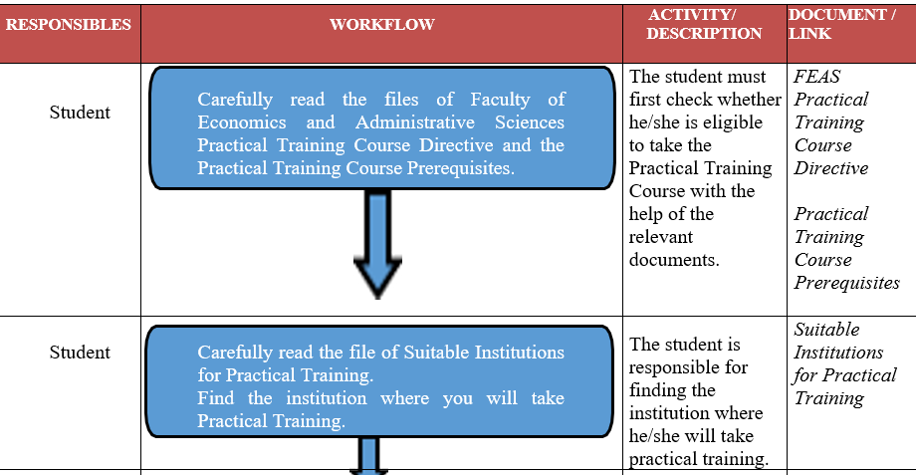
PRACTICAL TRAINING COURSE WORKFLOW DIAGRAM

Slide 11
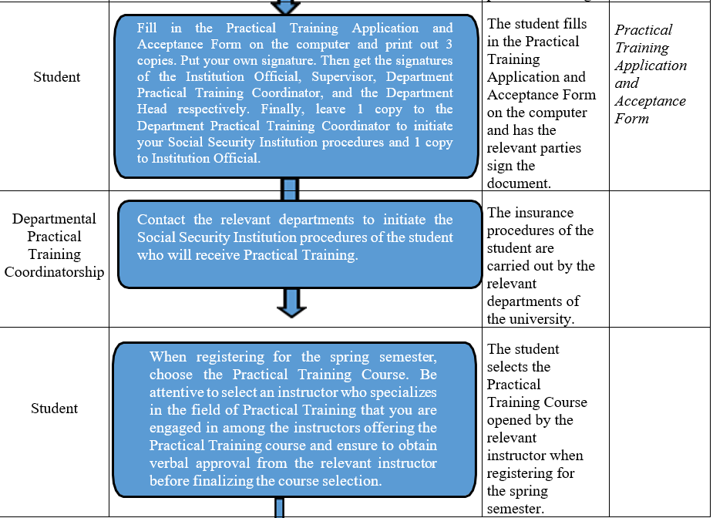
PRACTICAL TRAINING COURSE WORKFLOW DIAGRAM

Slide 12
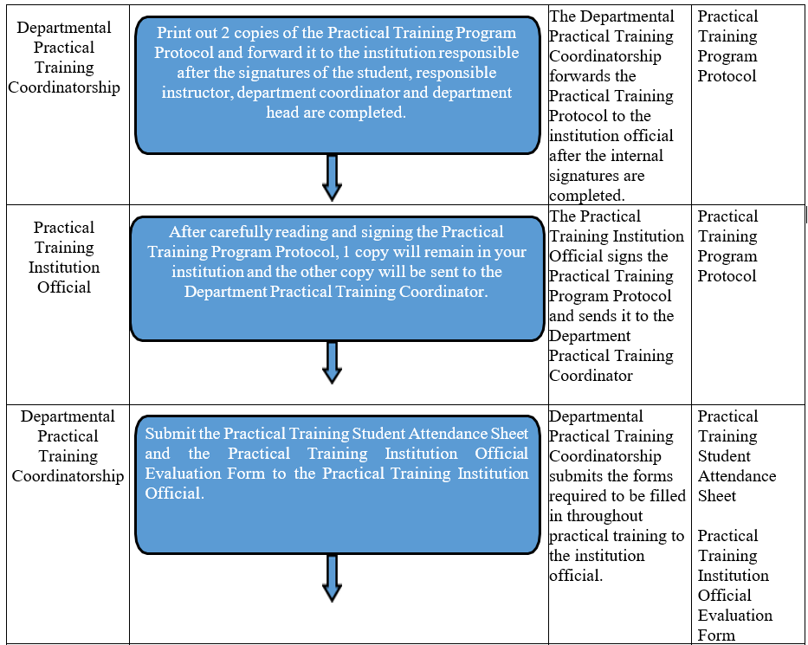
PRACTICAL TRAINING COURSE WORKFLOW DIAGRAM

Slide 13
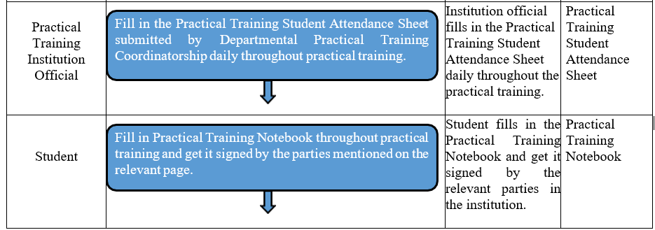
PRACTICAL TRAINING COURSE WORKFLOW DIAGRAM

Slide 14
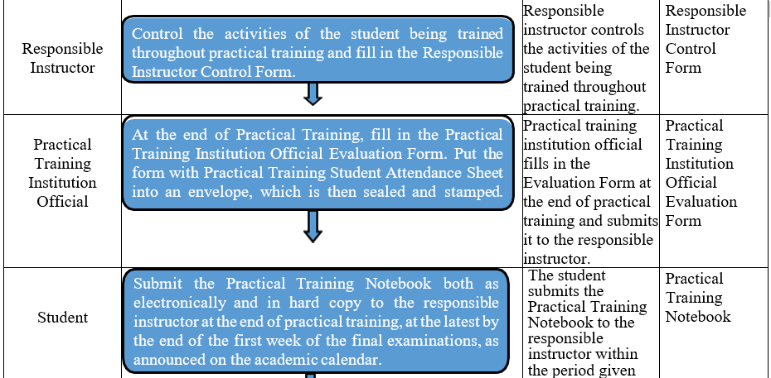
PRACTICAL TRAINING COURSE WORKFLOW DIAGRAM

Slide 15
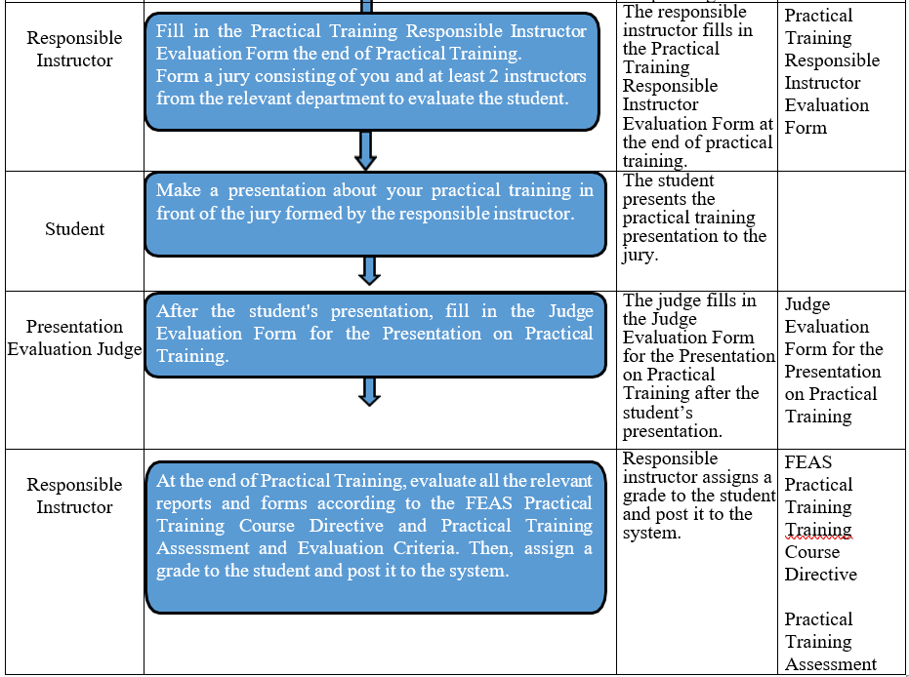
PRACTICAL TRAINING COURSE WORKFLOW DIAGRAM

Slide 16
PRACTICAL TRAINING – GENERAL PROVISIONS
With the conclusion of the practical training protocol, the health insurance of the students attending the practical training course at the institutions is made by Yalova University according to the provisions of the Social Security Insurance.
The total duration of excused or unexcused absences of students during their practical training in institutions cannot exceed 10% of the practical training period. Students whose total absenteeism time, including the report, exceeds 10% of the working day will fail.
During the practical training period, students do not have the right to leave. However, in cases deemed necessary within the knowledge of the practical training institution supervisor and the Department Coordinator of Practical Training Course, the student may be given permission not to exceed 7 (seven) working days.
The practical education of the student who does not go to the institution for more than 3 (three) days without permission or excuse is terminated. The situation is notified by the institution in writing to the Department Coordinator of Practical Training Course.

Slide 17
STUDENT DUTIES AND RESPONSIBILITIES
1. To fill in the Practical Training Application and Acceptance Form and have it approved by the relevant parties
2. To comply with the provisions of the "Regulation on Student Discipline of Higher Education Institutions" as well as the rules regarding work, discipline, and occupational safety of the institution where they continue their practical training
3. To perform the duties assigned to them by the Institution Official
4. Not to communicate private information of the organization to third parties
5. To use all kinds of institutional tools and equipment with care

Slide 18
STUDENT DUTIES AND RESPONSIBILITIES
6. Not participating in union activities
7. Regular attendance to practical training
8. Informing the Responsible Instructor and the Institution Official about all kinds of excuses and requests regarding their education. Obtaining permission from the Institution Official in obligatory situations which require them to leave the Institution.
9. Summarizing the daily activities in the Practical Training Notebook during the practical training, having this notebook approved by the relevant persons and delivering the Practical Training Notebook as printed and electronically to the Responsible Instructor in charge at the end of the practical training, until the end of the first week of the final exams according to the academic calendar.

Slide 19
STUDENT DUTIES AND RESPONSIBILITIES
10. Informing the Responsible Instructor and the Institution Official in case they get a health report, within the same day and delivering the original report to the academic unit which they connected within 3 days at the latest.
11. Not to change the practical training workplaces in the institution without the knowledge of the Institution Official and carefully using all kinds of tools and equipment, since they will be held personally responsible for the accidents and damages that may arise if they act on the contrary.
12. Not to change the institution where they get practical training without the written approval of the Institution Official and the Department Coordinator.

Slide 20
PRACTICAL TRAINING ASSESSMENT AND EVALUATION CRITERIA
ARTICLE 17- (1) The responsible instructor measures the success of the students by taking into account the training report to be submitted by the students and the report to be submitted by the practical training course institution official.
(2) The grade of the institution official is accepted as the midterm exam grade, and the grade determined by the responsible instructor according to the reports prepared by the student is accepted as the final exam grade.
(3) If students fail the practical training course, they are required to take the same course or another practical training course instead.
(4) In case of failure in compulsory practical training courses, the same course must be taken again.
(5) There is no make-up for unsuccessful students.
(6) The total number of hours or ECTS of the practical training done by the student is recorded in the transcript.

Slide 21
PRACTICAL TRAINING ASSESSMENT AND EVALUATION CRITERIA
Based on these issues specified in Article 17 of Yalova University Faculty of Economics and Administrative Sciences Practical Training Course Directive, the additional issues determined by the Department Board Decision are as follows:
In the calculation of the student's final grade in the Practical Training course, the grade of the institution official replaces the midterm, and the grade determined by the responsible instructor of the course replaces the final exam grade. Final exam grade is calculated by taking:
1) 70% of the grade determined by the Responsible Instructor in the Practical Training Responsible Instructor Evaluation Form,
2) 30% of the grade determined by the judge for the presentation made by the student at the end of the Practical Training. The judge will include at least 2 instructors from the relevant department together with the Responsible Instructor.

Slide 22
CONTACT DETAILS
Departmental Practical Training Coordinatorship
Assoc. Prof. Sinem Ateş (1. Floor Room: 452)
0 226 815 61 17
sinem.ates@yalova.edu.tr
Res. Ass. Filiz Ercan (1. Floor Room: 412)
0 226 815 51 23
filiz.ercan@yalova.edu.tr
https://isletme.yalova.edu.tr/en/Page/Icerik/71-practical-training

Slide 23
Thank you

